Slide 1
Project 1
Ames Housing
MSDS 6372
Anish Bhandari
William Jones
Nicholas Sager

Slide 2
TABLE OF CONTENTS
01
02
03
Project Objective
Data
Exploratory Data Analysis(EDA)
04
05
06
Interpretable Model
Predictive Models
Path Forward

Slide 3
Project Objective
Build interpretable regression models to identify and interpret key relationships.
Develop complex predictive models that prioritize accuracy, comparing multiple models to find the best performer for future data

Slide 4
Data
Kaggle
Cleanup
Analysis
Impute NAs
Test, train
EDA, Modelling

Slide 5
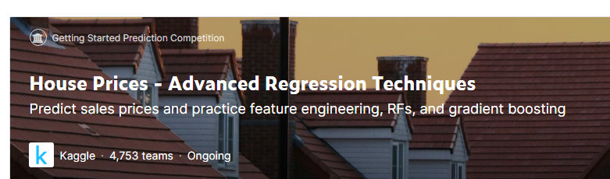
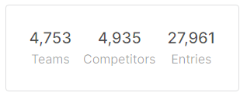
Data - Kaggle
https://www.kaggle.com/competitions/house-prices-advanced-regression-techniques/data
2 files - train.csv and a test.csv
Both the datasets have 79 explanatory variables
Sales price is the response variable
The train dataset -1460 unique rows , test dataset - 1459 unique rows
For the purpose of our modeling exercise, we will solely utilize the train dataset
Test dataset to facilitate predictive performance using Kaggle prediction scores

Slide 6
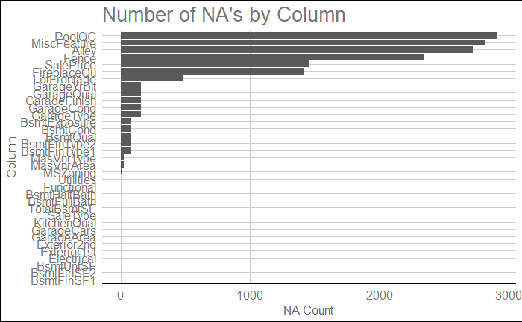
Data - Cleanup

Slide 7
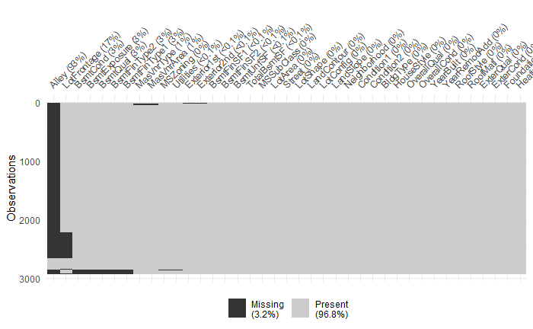
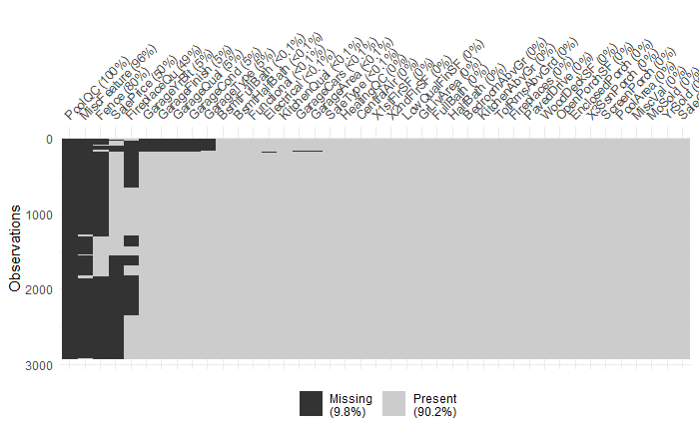
Data - Cleanup

Slide 8
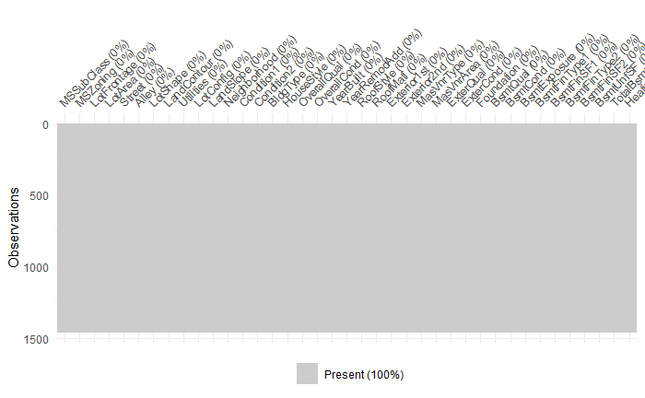
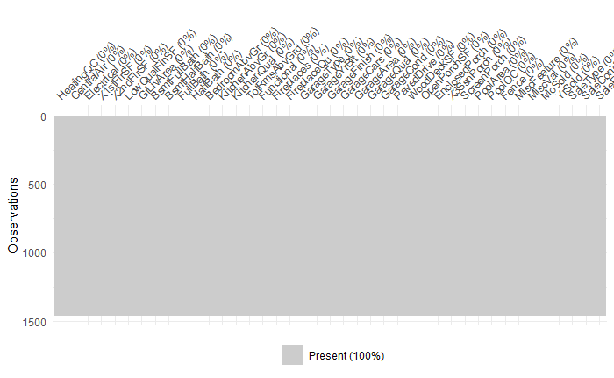
Data - Cleanup
None or 0
Mean
Missing not at random
Pool related, Garage related, Basement related, Fence, Fireplace, Alley, Misc.
Missing at random
Sale Type, Kitchen Quality etc.

Slide 9
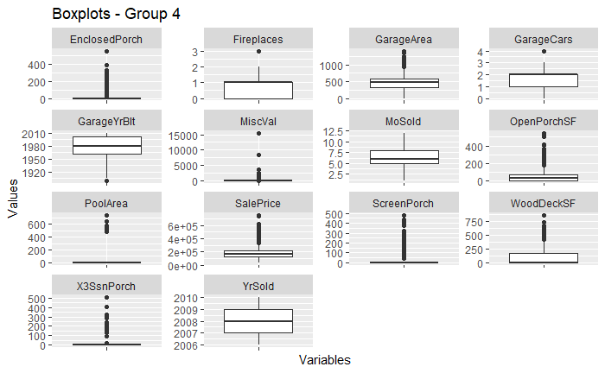
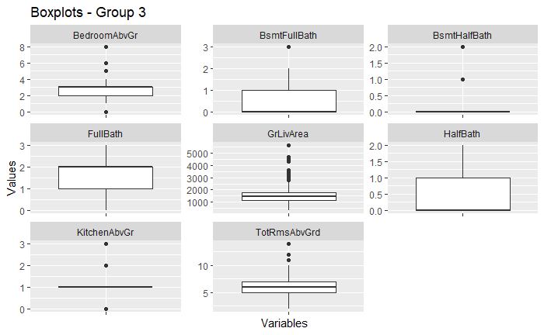
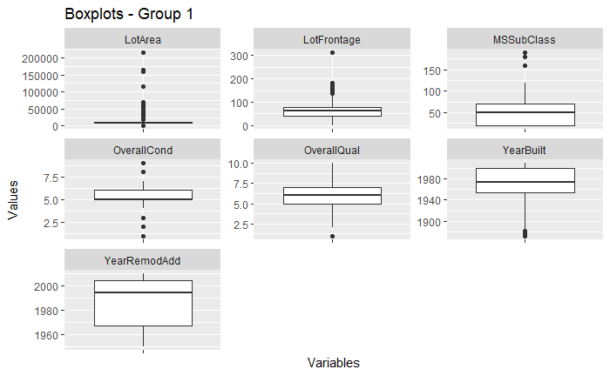
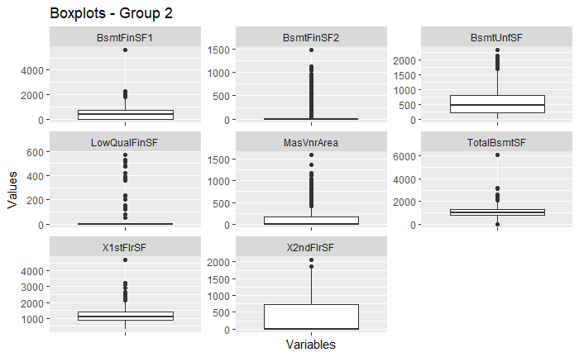
EDA - Numerical
Most data distribution right skewed
Year Built, Year Remodel, Garage Year Built, Garage Cars – Left skew
Response variable Sale price also right skewed with outliers at higher price range

Slide 10
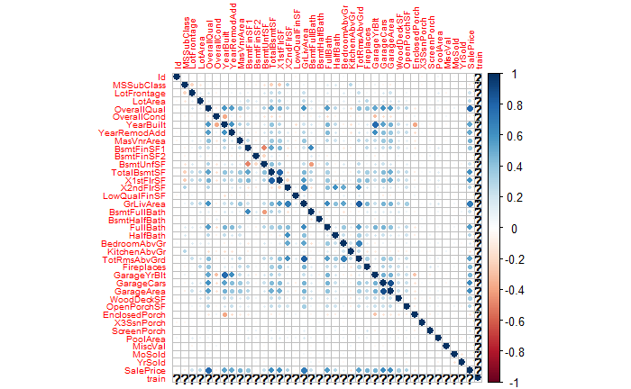
EDA - Numerical
Strong correlations
OverallQual (0.791)
GrLivArea (0.709)
GarageArea(0.623)
GarageCars (0.640)
X1stFlrSF (0.606)
TotalBsmtSF (0.614)
FullBath (0.561)
TotalRmsAbvGrd (0.534)
YearBuilt (0.523)
YearRemodAdd (0.507)

Slide 11
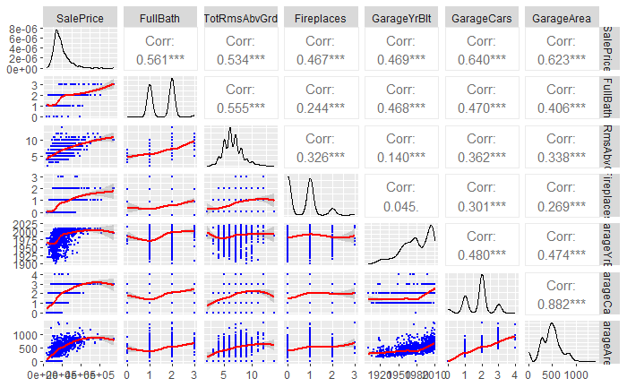
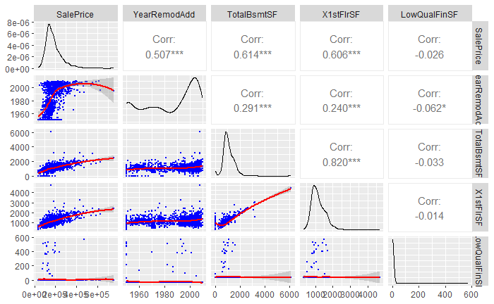
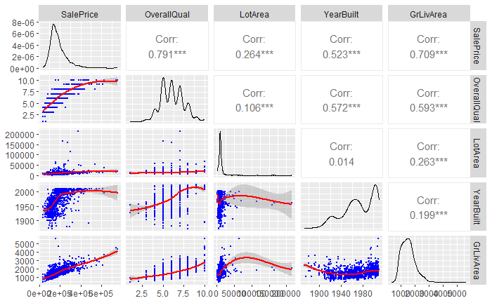
EDA - Numerical

Slide 12
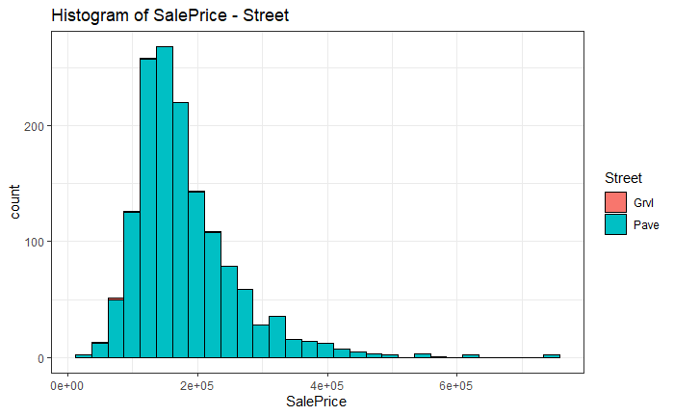
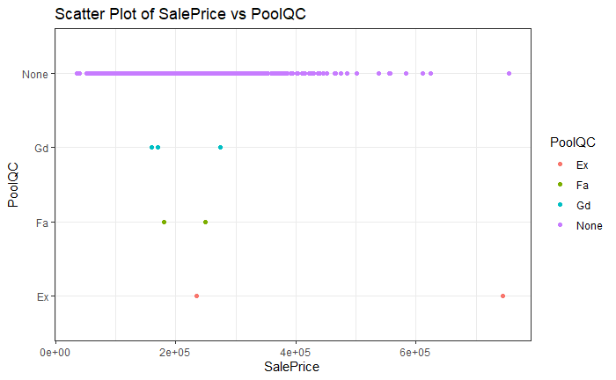
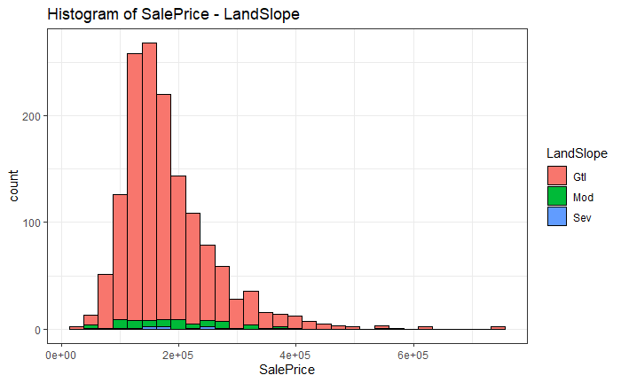
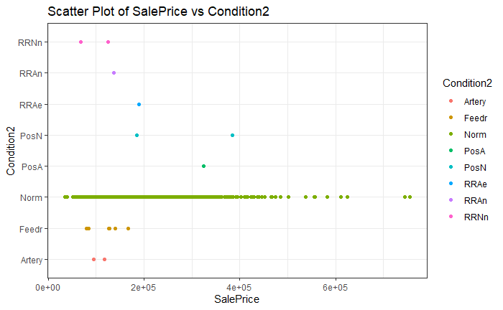
EDA - Categorical
Examples of variables potentially unfavorable to modelling

Slide 13
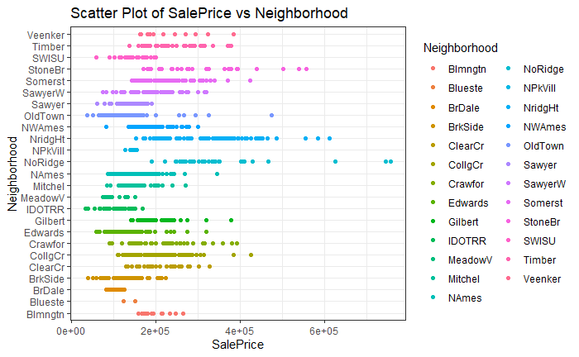
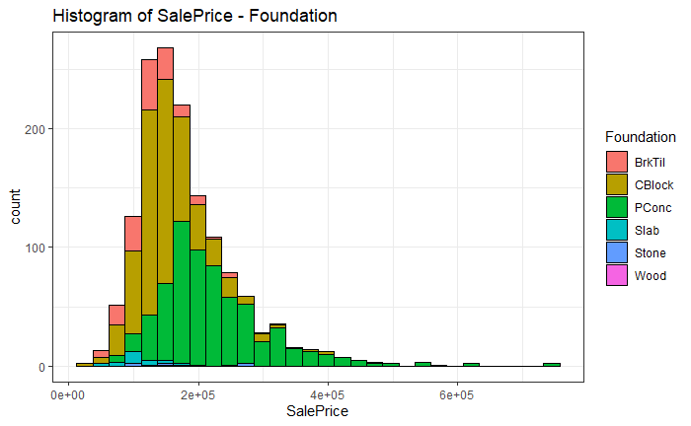
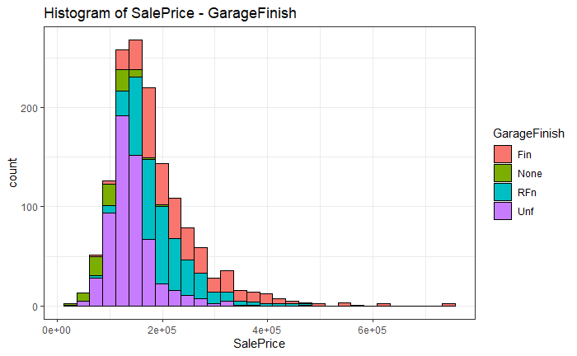
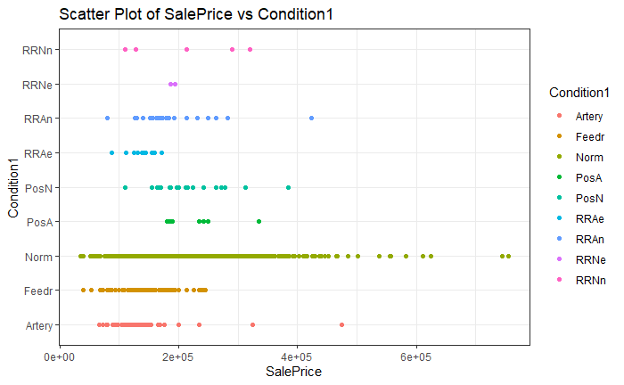
EDA - Categorical
Examples of variables potentially favorable to modelling

Slide 14
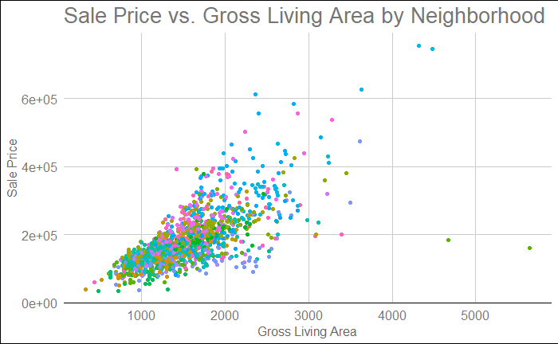
EDA - Categorical
Categorical Variables
Dummy Variables
Significance Check
(p-value)
Significant:
Neighborhood
lot_config_fr2 house_style1story
exter_qual_gd fireplace_qu_none sale_type_con
Potential model feed

Slide 15
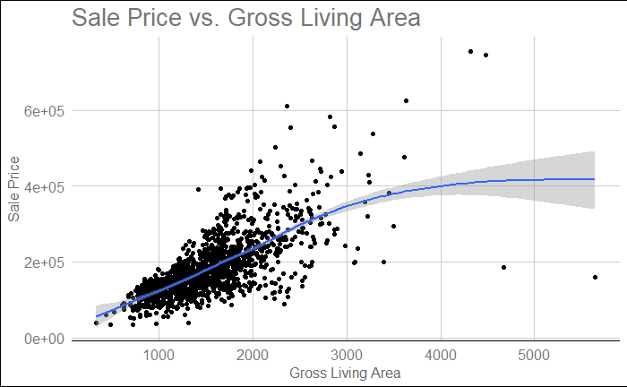
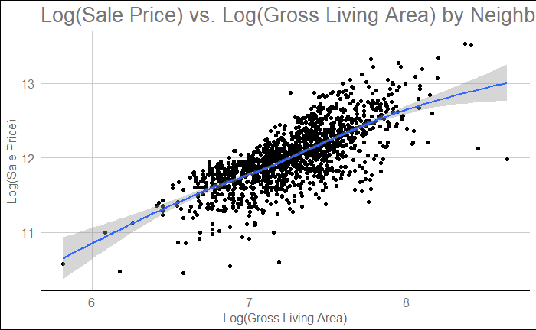
EDA - Categorical
log y, log x : Appears linear compared to untransformed
Potential for predictive model

Slide 16
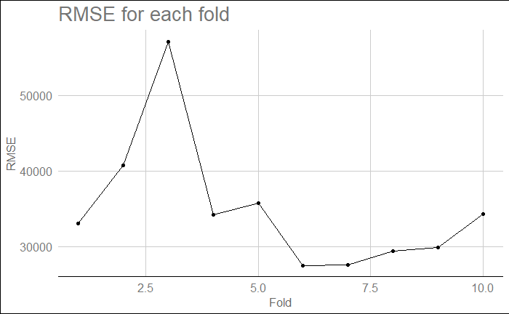
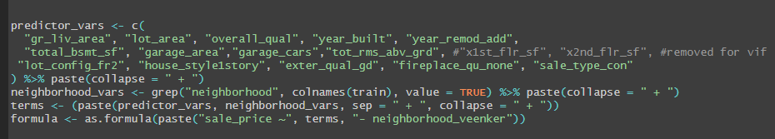
Interpretable Model

Slide 17
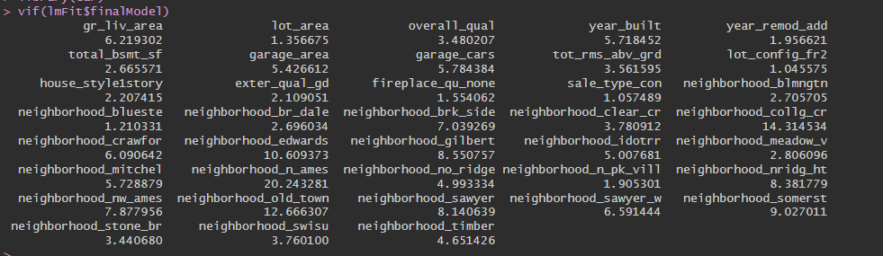
Interpretable Model
Some neighborhoods with high collinearity

Slide 18
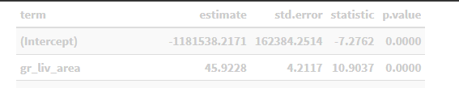
Interpretable Model
Holding all other variables constant a one hundred square foot increase in gross living area is associated with a $4,593 increase in sale price (p < 0.001 from linear regression). Based on our model, we can be 95% confidence that the true increase in sale price is between $4,171 and $5,013 for a one hundred square foot increase in gross living area.
Holding all other variables constant, being located in the Old Town neighborhood is associated with a $47,703 decrease in sale price compared to a house in the Veenker neighborhood (p < 0.001 from linear regression). Based on our model, we can be 95% confident that the true decrease in sale price is between $35,888 and $59,518 for a house in the Old Town neighborhood compared to a house in the Veenker neighborhood.

Slide 19
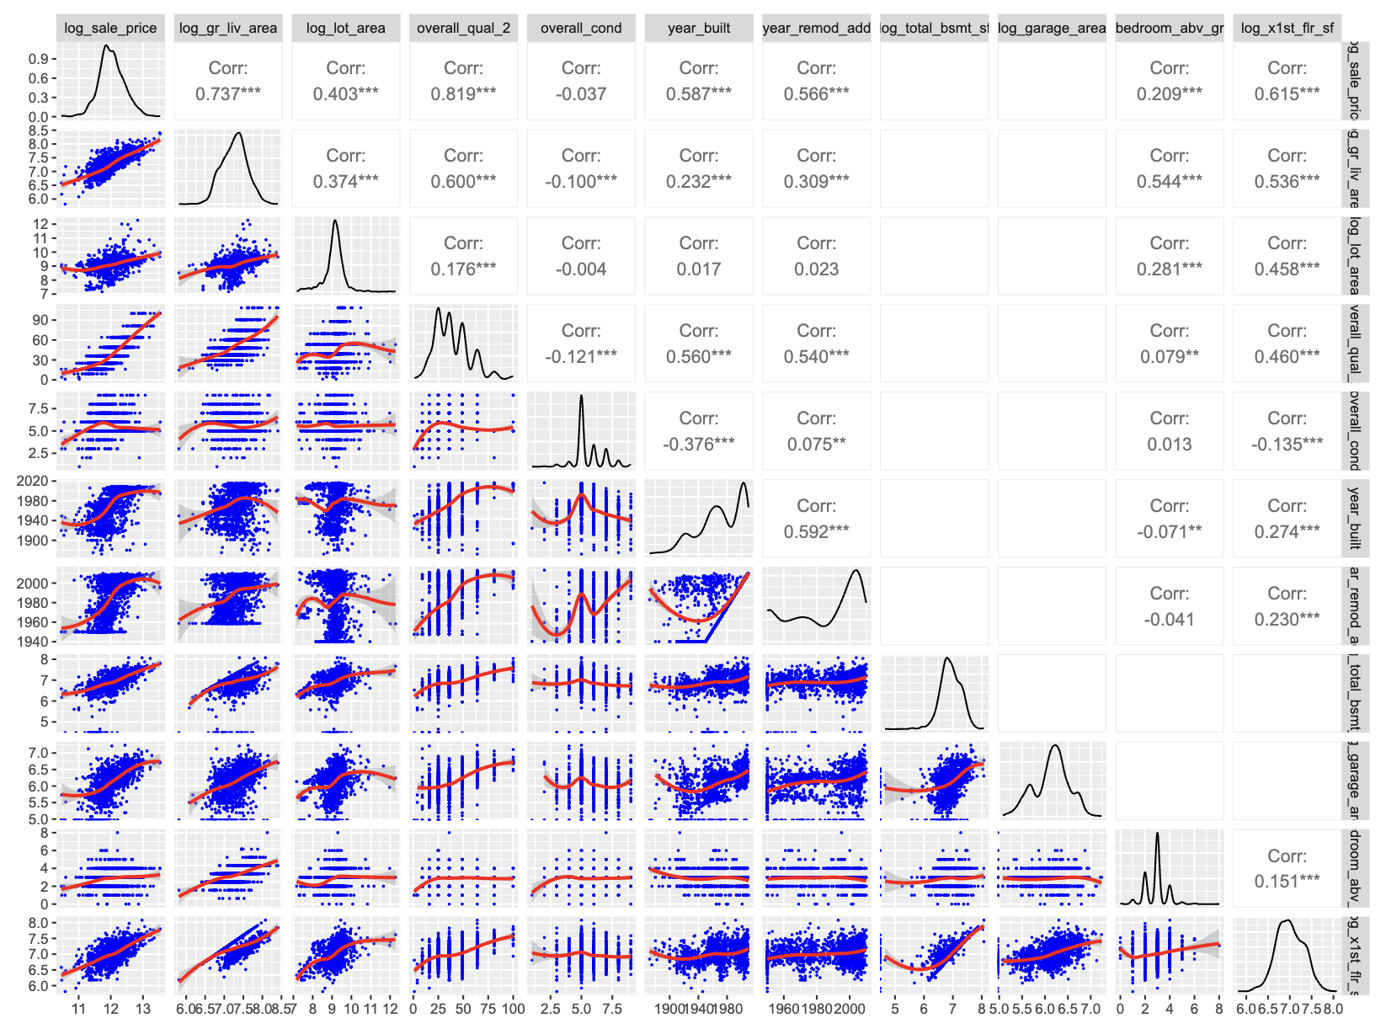
Complex Linear Regression
To add complexity, we include the transformations discussed in the EDA:

Slide 20
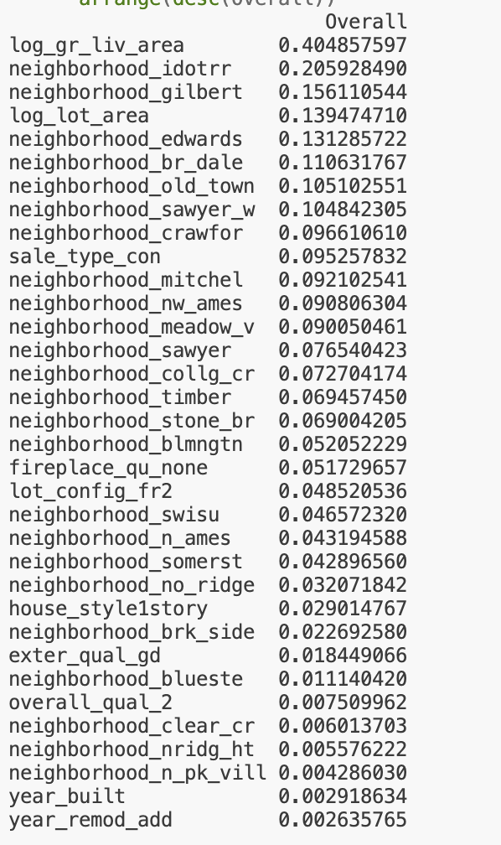
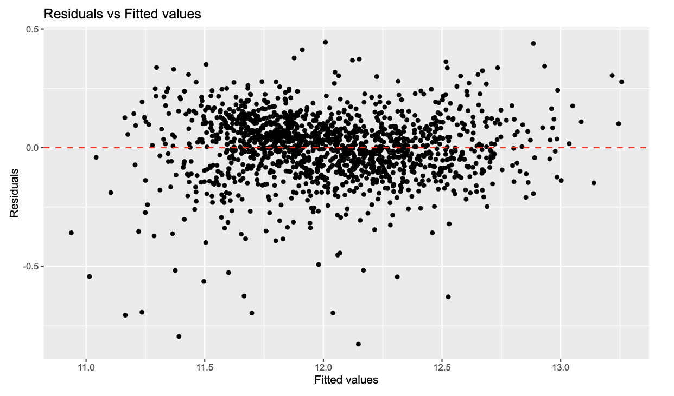
Complex Linear Regression
The linear regression model with transformations does better than the interpretable model.
The RMSE is 0.0152 on the log scale which translates to roughly a 16% multiplicative change on the original scale.
Interpreting this is difficult due to the complexity of the model, but this approximately corresponds to a $27,000 error in the predicted sale price. This is a significant improvement over the $30,000 error from the interpretable model.
The assumptions of linear regression appear to be better met after the transformations:

Slide 21
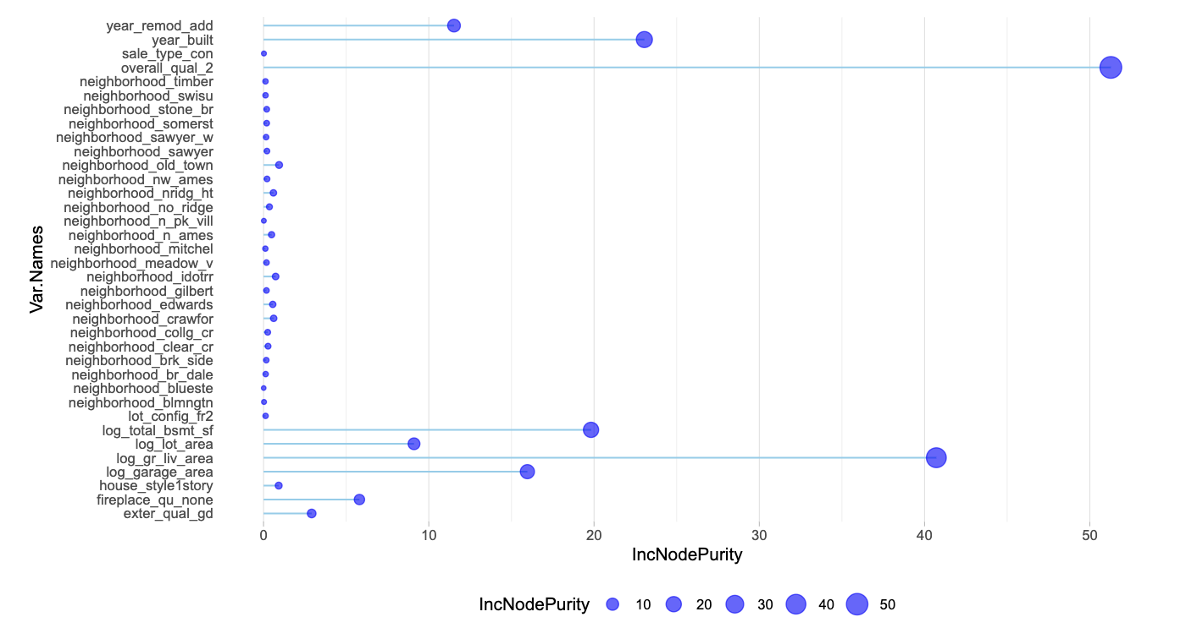
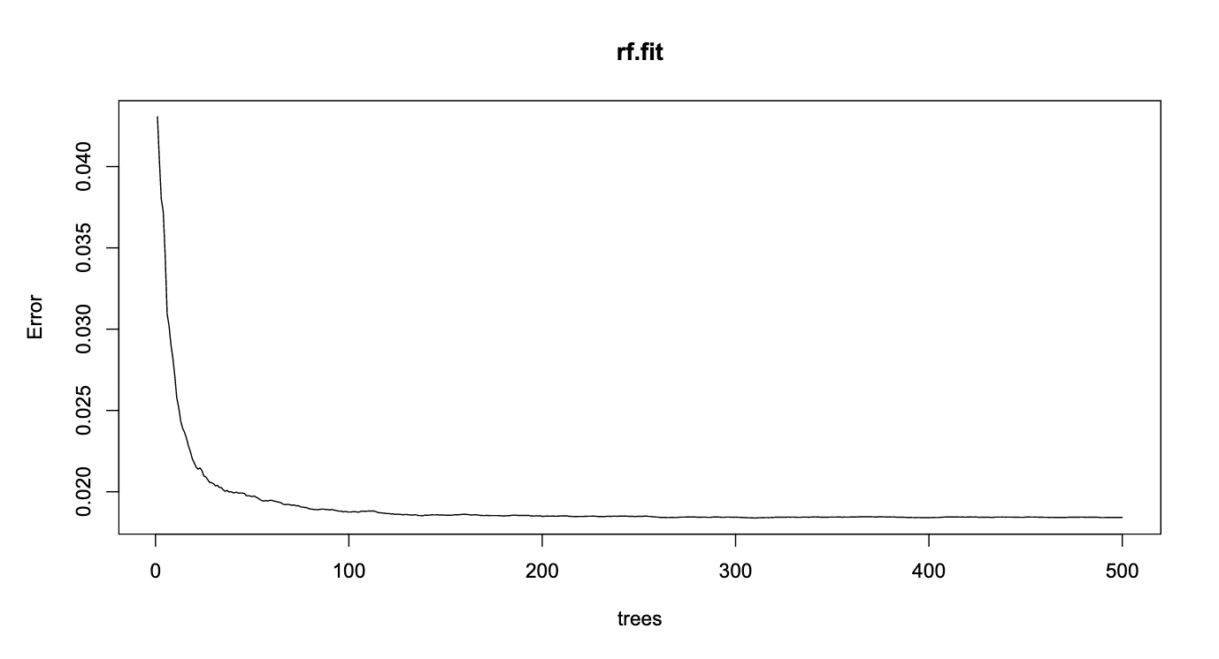
Random Forest
Random Forest Results:
RMSE: 0.018

Slide 22
Model Comparison
Linear Regression
Complex LR
Highly useful for interpretation. Moderate predictive power.
Decreasing interpretability as complexity improves the predictive power.
Random Forest
Model | Error | Interpretability
LR | ~$30,000 | Very High
CLR | ~$27,000 | Medium
RF | Low | Low
Useful for feature selection.
Hard to interpret.

Slide 23



OUR TEAM
THANKS
Anish Bhandari
asbhandari@mail.smu.edu
William Jones
wfjones@mail.smu.edu
Nicholas Sager
nsager@mail.smu.edu

